Slide 1
TNSDC-Generative AI
FACE DETECTION USING DEEP LEARNING
Presented by : HARISH.P,
au211521104050,
Pre-Final Year Student,
Computer Science and Engineering,
Panimalar Institute of Technology.

Slide 2

OUTLINE
Problem Statement
Proposed Solution
System Approach
Algorithm
Result
Conclusion
References

Slide 3
PROBLEM STATEMENT
Face detection is a crucial task in computer vision with a wide range of applications including facial recognition, surveillance, security systems, and image editing. Traditional methods for face detection often rely on handcrafted features and algorithms, which may not perform well in challenging conditions such as varying lighting, poses, and occlusions.
The problem is to develop an accurate and efficient face detection system using deep learning techniques. The system should be capable of detecting faces in images or video frames with high precision, robustness, and scalability.

Slide 4
PROPOSED SOLUTION
The proposed solution for face detection using deep learning involves several key steps. Initially, a diverse dataset of face images is collected and annotated, followed by the selection of a suitable deep learning architecture like Faster R-CNN or YOLO. The model is then trained using transfer learning, fine-tuning on the collected dataset, and optimizing with appropriate loss functions and optimization techniques. Post-processing methods such as non-maximum suppression are applied to refine the detections. Evaluation metrics like precision, recall, and mAP are used to assess performance, followed by fine-tuning and optimization for deployment on various platforms. Continuous monitoring and maintenance ensure the model's efficacy in real-world scenarios, enabling robust and efficient face detection across diverse environments.

Slide 5
SYSTEM APPROACH
Hardware:
CPU: A multi-core processor with a clock speed of at least 2 GHz is recommended for handling the computational demands of CNN training and inference.
Memory: A minimum of 8 GB RAM is necessary for smooth operation, particularly during model training with large datasets.
GPU: A powerful graphics card, such as the NVIDIA RTX 4070, with CUDA cores is essential for accelerating image rendering tasks, particularly in deep learning applications like CNN training and inference.
Internet Speed: A stable broadband connection with a minimum download speed of 5 Mbps and upload speed of 1 Mbps is required for package downloads, updates, and web application serving.

Slide 6
SYSTEM APPROACH – CONT.
Software:
Jupyter: Enables interactive development and experimentation through Notebooks, facilitating Python code execution.
NumPy: Fundamental for scientific computing, it manages multidimensional arrays and executes mathematical operations within TensorFlow.
Matplotlib: Facilitates data visualization and plotting, aiding in analyzing and interpreting model performance and results.
Scikit-learn: Offers various machine learning algorithms and tools for model evaluation and validation, complementing TensorFlow for comprehensive model development.
Develop a user-friendly interface for interacting with the face detection system, allowing users to provide input, visualize results, and adjust settings if needed.

Slide 7

ALGORITHM
Import necessary libraries:
Import OpenCV library.
Load pre-trained face detection model:
Load the Haar cascade classifier for face detection. You can find pre-trained XML files for the classifier in the OpenCV package.
Load and preprocess the image:
Load the image using OpenCV's imread() function.
Detect faces:
Convert the image to grayscale using cvtColor() function.
Use the detectMultiScale() function of the face cascade classifier to detect faces in the grayscale image.
Adjust parameters like scaleFactor, minNeighbors, and minSize for better detection performance.
Draw bounding boxes around detected faces:
Iterate over the detected faces and draw rectangles around them using the rectangle() function.
Display the image with detected faces:
Use imshow() function to display the image with bounding boxes.
Wait for a key press using waitKey() function.
Close all OpenCV windows using destroyAllWindows().

Slide 8
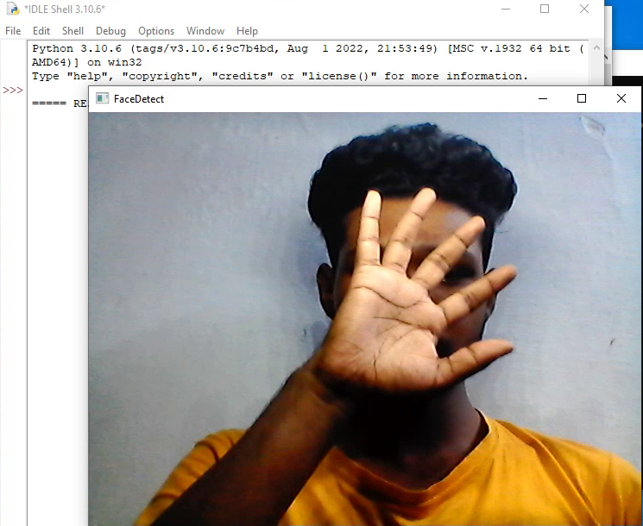
RESULT
8

Slide 9
Conclusion
In conclusion, face detection using deep learning techniques has revolutionized the field of computer vision, enabling accurate, robust, and efficient detection of faces in various real-world scenarios. By leveraging deep neural networks and large-scale datasets, these methods have surpassed traditional approaches by achieving higher accuracy, scalability, and adaptability to diverse environments. The utilization of pre-trained models, transfer learning, and optimization strategies further enhances the performance and efficiency of face detection systems.
Furthermore, the deployment of deep learning-based face detection models on edge devices and embedded systems opens up opportunities for real-time applications in surveillance, security systems, and human-computer interaction. However, challenges such as privacy concerns, algorithmic biases, and computational resource constraints require careful consideration and ongoing research.
9

Slide 10
REFERENCES
Viola, P., & Jones, M. J. (2001). Rapid object detection using a boosted cascade of simple features. Proceedings of the 2001 IEEE Computer Society Conference on Computer Vision and Pattern Recognition.
Lienhart, R., & Maydt, J. (2002). An extended set of Haar-like features for rapid object detection. Proceedings of the 2002 International Conference on Image Processing.
Zhang, Z., Luo, P., Loy, C. C., & Tang, X. (2016). Joint face detection and alignment using multitask cascaded convolutional networks. IEEE Signal Processing Letters, 23(10), 1499-1503.
10

